Slide 1
Information Gathering and Reconnaissance with AI
Harnessing Artificial Intelligence for Penetration Testing

Slide 2
Gathering Information
Gather Information
Collecting Information about a Target's Digital Environment to Understand its Vulnerabilities
Network Topology
System Strengths and Weaknesses
Identifying Possible Entry Point
Scanning
Exploitation
Maintaining Access
Covering Tracks
Reporting and Documentation

Slide 3
Gathering Information traditional methods
Open Source Intelligence (OSINT)
WHOIS Lookup
Social Engineering
“psychological manipulation of a person to get useful and sensitive information from them” ^{[1]}
Notes:
[1] C. Chebbi, Mastering Machine Learning for Penetration Testing, Packt Publishing, 2018.

Slide 4
Gathering Information Importance of AI
Automated Data Collection
Data Processing
Data Analysis and Interpretation
Natural Language Processing
Predictive Analytics
Machine Learning for Target Profiling

Slide 5
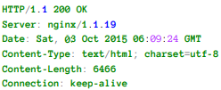
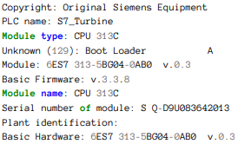
AI Tools for Gathering Information Shodan
Notes:
[photos] [2] J. Matherly, Complete Guide to Shodan, Leanpub, 2016.

Slide 6
AI Tools for Gathering Information nmap
Nmap (with AI plugins)
Nmap Scripting Engine (NSE)
12 Useful NSE scripts: https://research.securitum.com/nmap-and-12-useful-nse-scripts/
Extensive script list: https://secwiki.org/w/Nmap/Script_Ideas
Notes:
https://nmap.org/nsedoc/scripts/

Slide 7
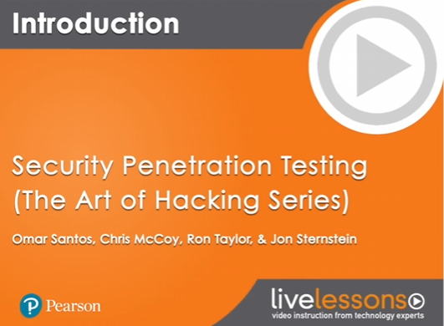
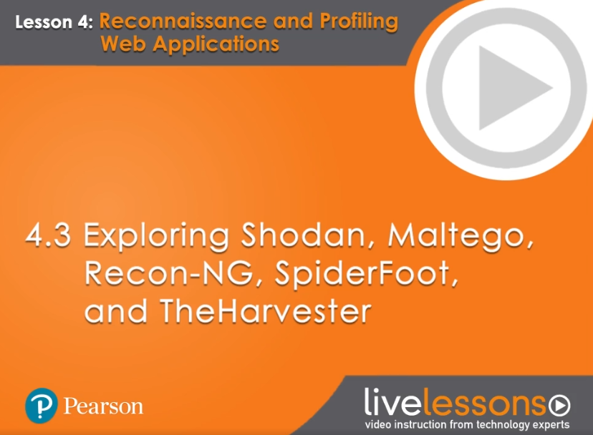
AI Tools for Gathering Information o’reilly course

Slide 8
Research Question
What are some creative challenges that real-world applications of these tools could help solve?

Slide 9
References
C. Chebbi, Mastering Machine Learning for Penetration Testing, Packt Publishing, 2018.
J. Matherly, Complete Guide to Shodan, Leanpub, 2016.
N. Kühl, M. Schemmer, . M. Goutier and G. Sat, Artificial intelligence and machine learning, 2022, pp. 2235-2244.
S. Watts , Penetration Testing: Practical Introduction & Tutorials, 2022.
A. AlMajali, L. Al-Abed, R. Mutleq, Z. Samamah, A. A. Shhadeh, B. J. Mohd and K. M. Ahmad Yousef, "Vulnerability Exploitation Using Reinforcement Learning," in Jordan International Joint Conference on Electrical Engineering and Information Technology, Amman, 2023.
S. Morgan, 2023 Cybersecurity Almanac: 100 Facts, Figures, Predictions, And Statistics, Sausality, California, 2023.
Notes:
Thank you!

